Slide 1
Welcome ... To everybody individually ...
... Collectively and appropriately on FA Cup Final Day, a team!

Slide 2
The Race For Space
It’s becoming a lot more competitive
Others are learning from experts in their field
No apologies for a few football analogies
We congratulate both teams for getting to the final
But what on earth are Hull City doing there?
Let’s see ...

Slide 3
Google moved the goalposts

Slide 4
The playing field is now wonky

Slide 5
Odd online results as per Premier League and FA Cup
Rochdale 2 - 0 Leeds
Chelsea 1 – 2 Stoke City
Crystal Palace 3 – 3 Liverpool

Slide 6
Sometimes outsiders win
Horse races
Golf
Ten pin bowling

Slide 7
In common ...
All trained
Practiced
Used support (dietician, physiotherapist etc)
Turned up
Played their best

Slide 8
Odd = ‘one offs’
Over time, a season for example, just one word applies for the cream to float to the top ...
Consistency
It wins league titles, Champions League and puts Tiger and Rory at the top of the pile

Slide 9
Complacency; a definition
“a feeling of quiet pleasure or security, often while unaware of some potential danger, defect, or the like; self satisfaction or smug satisfaction with an existing situation, condition, etc”
Just ask Leeds Utd!
Was their preparation as good for the Rochdale game as it was for the A.C. Milan match a few years earlier?

Slide 10
In Internet & Google terms …
2 ways to win … get to the top
Naturally with CONSTANT ACTION & CONSISTENCY.
Not with the cheque book, rather loan signings, youth academy and, above all, PATIENCE.
50 million new websites added in 2012!

Slide 11
Or …
Do what these did
‘Buy’ your way to the top! Google Pay per Click.

Slide 12
We have the same Options
Luckily you benefit from both Natural and PPC listings
Odd results still crop up
BASICS still apply

Slide 13
The Basics
Football – no matter how good the equipment is or training facilities are, still have to score more goals than the opponents. It is a team effort.
Golf – as above but working with the ‘team’ of caddy, swing coach, putting coach etc. The ball still has to go into the hole!
10 pin bowling – as above – knock more over than anybody else!
No Automatic Right To Win

Slide 14
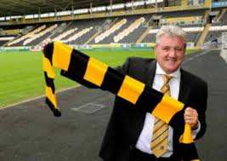
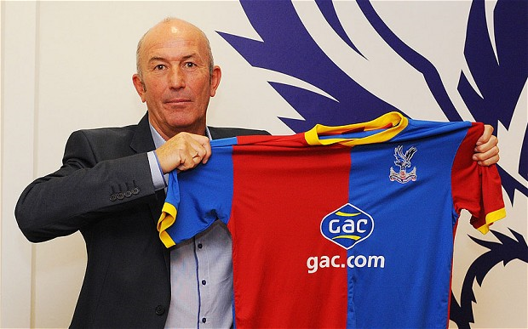
New equipment?
Rory took time to adjust to Nike
Most of the time ‘change’ is good
And it works most of the time.

Slide 15
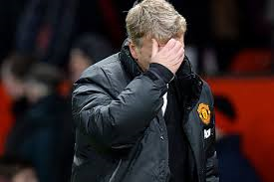
Sometimes it doesn’t!
Oh dear!

Slide 16
Where we’re at …

Slide 17
What and where from?

Slide 18
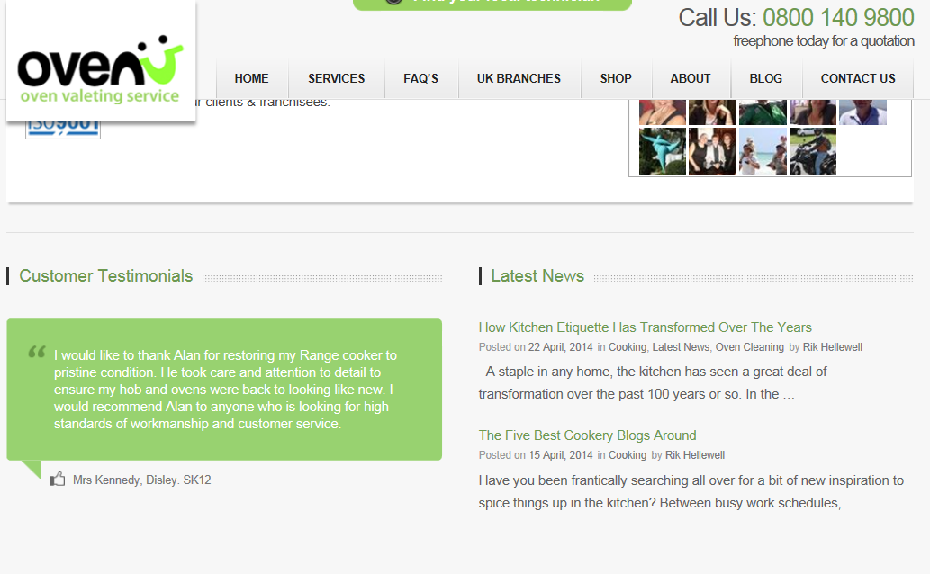
Organic is Good!
Google says to add content so we have
This is done by ‘Blogs’

Slide 19
Blogs Cost … and so does getting them seen
The days of FREE anything on the internet are numbered!
Cost = Time, Money or BOTH
First 3 months covered by HQ
Nat Ad Account thereafter
Reduction in PPC as a result (over £1,000)
IT WORKS
So does adding content locally via Testimonials*

Slide 20
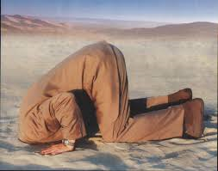
Getting Blogs seen
Social Media
Facebook
Twitter
Pintrest
Google+ …….. more on this later

Slide 21
Hey … thanks Google!
Google said to build links
We did … some of you did
They now say “It’s all about link quality NOT quantity”
Massive Link Review
Paid for by Yours Truly

Slide 22
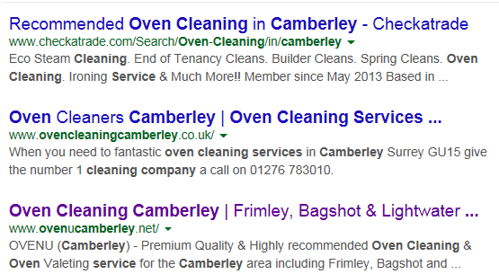
Local Results on the web …
Most rank very well for “oven cleaning (your area)”
Check yours during break … regularly thereafter
Some have slipped
Some for good reason
Some for no reason! (Odd results!)
Different results on different devices … check with others here today.

Slide 23
Result Types
Natural
Takes time
Needs consistency
Relatively low cost
More credible
Longevity
Tricky to replicate
Pay per Click
Immediate ‘short cut’
Costly
Increasingly competitive
Fixed budget
Easy to copy!

Slide 24
Some PPC costs a bomb!

Slide 25
Some doesn’t …

Slide 26
IT’S AN AUCTION!
Results can, and do, change daily
Costs vary….daily
Competitors are competing … daily
We have no influence over competitors
We have a FIXED BUDGET
Top positions = Top spend!
Option to contribute more will be available this year.

Slide 27
The Breaking Point
Clicks = Business
On average, tests show 10 clicks = 1 booking
10 clicks @ 30p is great
10 clicks @ £3.00 isn’t!
Please remember … it’s an auction over which we have absolutely NO INFLUENCE at all.

Slide 28
Champion’s League & Premiership
Both as per our Race for Space
Champion’s League … top 4
Missing out costs a fortune …ask these next year!
Premiership … top team wins (but everybody gets something!)

Slide 29
Take, take, take…
Applies to Internet and Google in particular
Sounds like it’s take, take and take because …
IT IS!
Google do have a FREEBIE though
Places for Business – replaces Places
And there’s Google+ for verified Places accounts
Ask Liam for a hand-out in the break

Slide 30
Our Team
You’re not alone!
We have a team to help you
First up to discuss Marketing …
Frances Bourne

Slide 31
Thanks Frances*
Excellent emphasis on ‘offline’
Re-Visit magazines
Re-visit drop-cards / brochures
Retro view is often good
WHY??
Because it works
Rob (Poole) and Chris (Guernsey) are worth chatting to.
Finding magazines and getting artwork correct??
Here to explain more ...
Fiona and Sam from ARC Media

Slide 32
Thank you Ladies
A generous discount – here’s hoping it’s used!
More discounts available NOW ...
SAVE on drop-card artwork
SAVE on drop-card printing
Part Two of arranging a door-drop is???
Short break of 20 minutes ..collect hand-out from Liam, Vikki & Shannon
Delighted to welcome Jeff Frankling.

Slide 33
Thank you Jeff
Times when the ‘Nike Theory’ ... ‘Just Do It’ applies
Somebody in our network did just this
Excellent results to back up what Jeff has said
The nest is feathered and door closing on competitors*

Slide 34
Public Relations
Massively important offline tool
Works in conjunction with online
Individually OK
Together ... AWESOME
Starting with another superb film from ‘Warrington Enterprises’
Introducing Graham and Marie from Recognition PR

Slide 35
Thank you Recognition
Well done again to Paul (Warrington)
Thanks to Graham and Marie
Short (20 minutes please) break
Donations to Wild Wings very welcome
Box by refreshments!
And, on return, let’s look at saving cash with Jon Lacey from Dennis & Turnbull

Slide 36
Welcome back ...
Ready to convert Plan B into Plan A???
Re-invigorated??
Opportunity to steal a march on competitors
You are NOT competing against each other!
Boost turnover
Boost profit
Pay more tax!!!

Slide 37
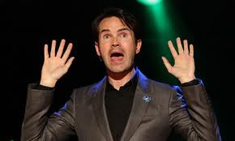
We all pay ... Don’t we?
Maybe not!

Slide 38
Ask your Accountant!

Slide 39
…and save on Accountancy
Hand-out available
Look at the figures
Let’s hear from the expert
Introducing Jon Lacey

Slide 40
Thank you Jon …
Looking after yourself and hard-earned cash!
There is more that can, and has, been done for you …
Insulated tank ... Denbighshire
The OVENU app ... http://webappbiz.co.uk/ovenugb.html
Vikki and Shannon will show you how to put this onto YOUR smartphone AND explain how to send it to clients!
The girls will also show you how to add a Digital Signature to your phone and/or tablet.

Slide 41
App Feedback and Kick Off
Please send feedback over the next couple of weeks
Kick off a few minutes away
Thanks to one and all.

